Slide 1




Web Technologies
Basic Concepts
Web Fundamentals
SoftUni Team
Technical Trainers
Software University
http://softuni.bg

Slide 2

Table of Contents
Web pages, Web Sites and Web Applications
Web 1.0, 2.0, 3.0
Web Browsers and Layout Engines
Hardware Servers
Web Servers

Slide 3
Table of Contents (2)
Client-Server Architecture
3-Tier / Multi-Tier Architectures
Service-Oriented Architecture & Cloud
Web Development Tools
IDEs, browser tools, drawing and slicing tools.

Slide 4
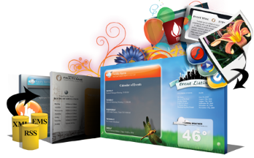
Web Pages, Sites and Applications

Slide 5
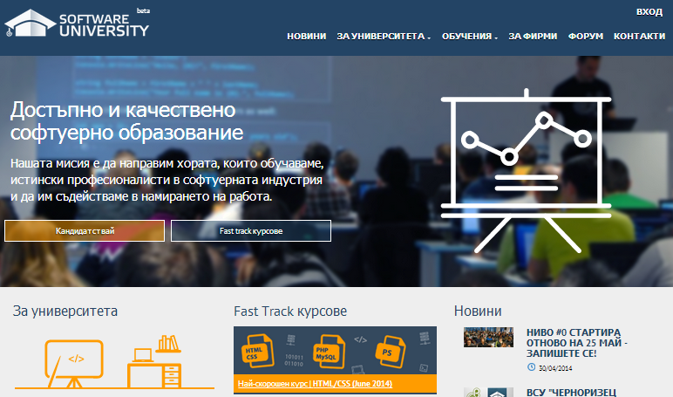
Web Page
Web document that is suitable for web browsers
Can be accessed through every device
Only Internet and Web browser is required
Web pages are usually written in HTML or XHTML
May contain text, graphics, hyperlinks, references to other resources
Stylesheets, scripts, images

Slide 6
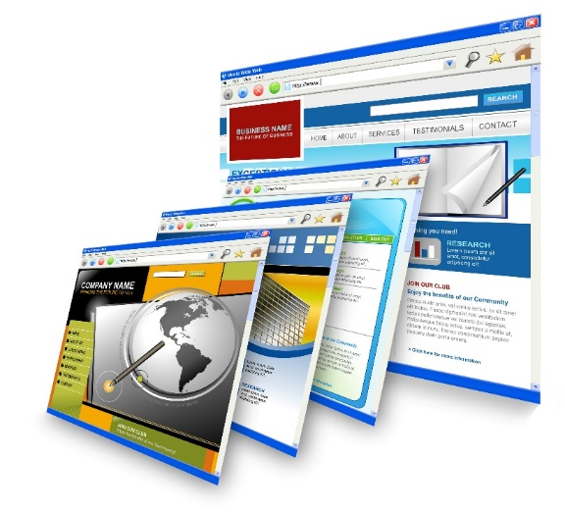
Web Site
Set of related web pages served from a single web domain
Hosted on one or more web servers (accessible via network)
Web sites consist of set of resources
Web pages, CSS styles, JS scripts, images, videos, …
World Wide Web (WWW)
All publicly accessible websites in Internet

Slide 7



Web Application / RIA / SPA
Software application that runs in a Web browser
Or is created in a browser-supported language (HTML + CSS + JS)
Applications are usually broken into logical chunks called "tiers"
High interactivity and accessibility
Allows personalized dynamic content to be pulled down by users
According to individual settings

Slide 8

Web Browsers and Layout Engines

Slide 9
Web Browser
Web browsers visualize Web content
Render HTML, images, CSS, videos, JavaScript, etc.
Software application for retrieving, presenting and traversing information resources on the World Wide Web
An information resource is identified by a URI / URL and may be a web page, image, video or other piece of content
Can used to access information provided by web servers in private networks or files in file systems

Slide 10
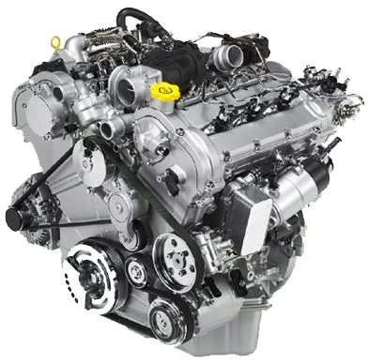
Layout Engine
Takes marked up content (HTML, XML, images, files, ...) + formatting information (CSS, XSL, …)
Displays the formatted content on the screen
A layout engine is typically embedded in web browsers, e-mail clients, e-book readers, on-line help systems
To display Web content
Different devices run different layout engines
Render HTML and CSS differently
http://www.html5rocks.com/en/tutorials/internals/howbrowserswork/

Slide 11











Layout Engines and Web Browsers
Blink
Chrome, Opera 15+
Gecko
Firefox, Netscape, SeaMonkey, …
Trident
Internet Explorer, Maxthon
WebKit
Old Chrome, Safari
Presto and others
Old Opera

Slide 12
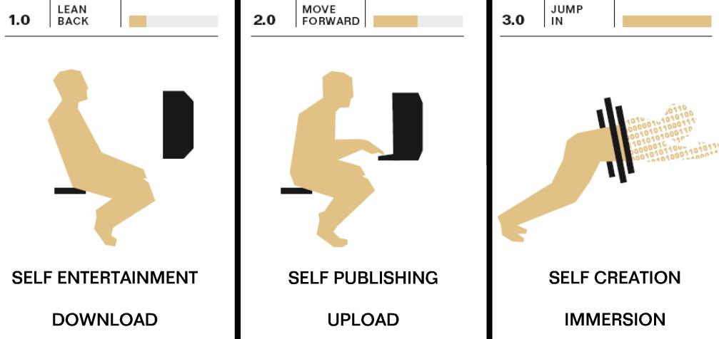
Web Evolution – History and Future
Web 1.0 – 4.0

Slide 13
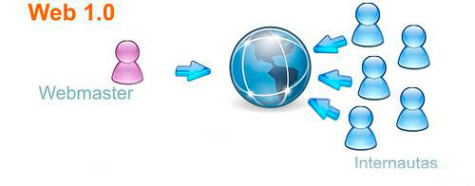
Web 1.0
Experts call the Internet before 1999 “Read-Only” web
Sites are static. They might contain useful information, but there's no reason for a visitor to return to the site later.
Low variety of content
Sites aren’t interactive
Applications are proprietary
10 000 editors server 500 millions internet users

Slide 14
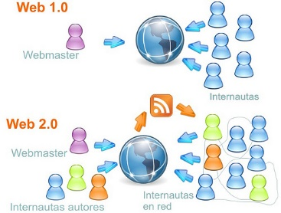
Web 2.0
The writing and participating web (User-generated content)
New applications may allow every users to interact and collaborate with each other in a social media dialogue as creators of content
What is Web 2.0?
Rich Internet Applications (RIA)
Social Web
Web-Oriented Architecture (WOA)
RSS, Web services, feeds, etc.

Slide 15
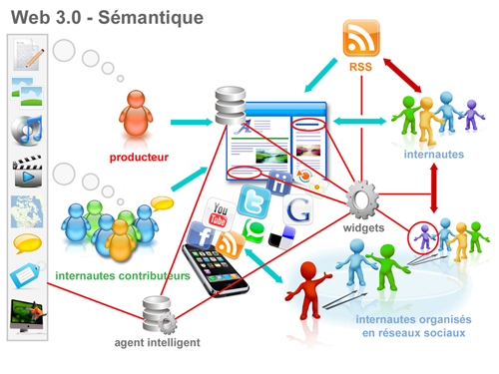
Web 3.0
"Semantic Web" is sometimes used as a synonym for "Web 3.0“
The Web 3.0 browser will analyze your response, search the Internet for all possible answers, and then organize the results for you
Artificial intelligence
Personalization
Mobility
Semantic Web

Slide 16
Web 4.0
“The next Web” – the ultra-intelligent electronic agent
Recognize you when you get in front of it because all of your devices are getting a little camera
And with facial recognition, they’ll know it’s you
Web 4.0 is often characterized as the Web OS
The entire web being a single operating system where information flows from any one point to any other

Slide 17
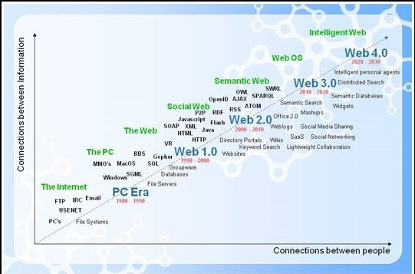
Web Evolution
http://www.evolutionoftheweb.com/

Slide 18
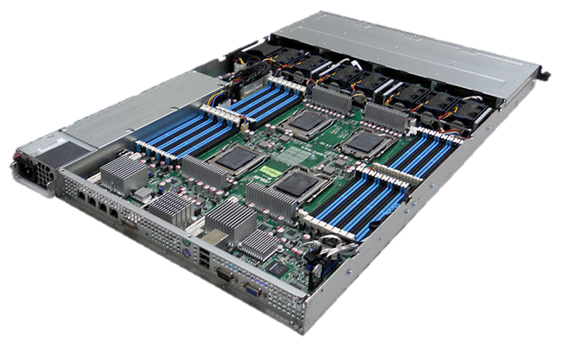
Hardware Servers

Slide 19
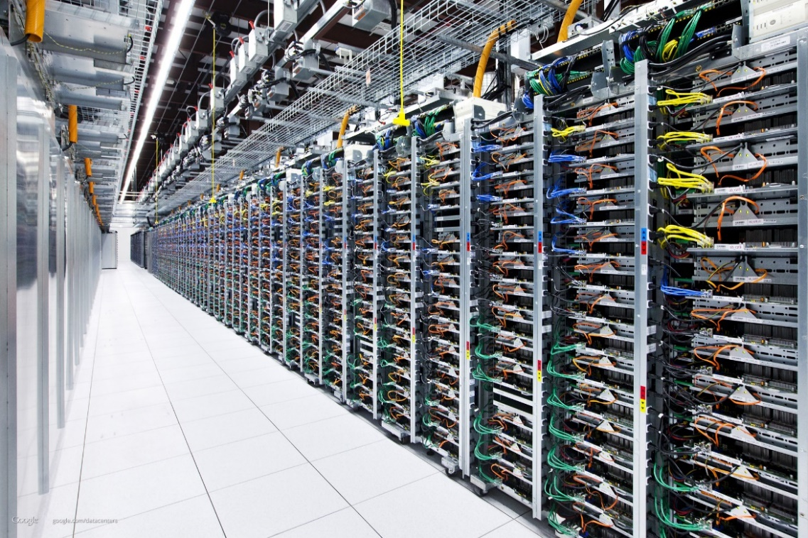
Hardware Server
Physical computer (a hardware system) dedicated to running one or more such services
Usually servers are placed in data centers
Typical computing servers are:
Database server
File server
Mail server
Web server

Slide 20
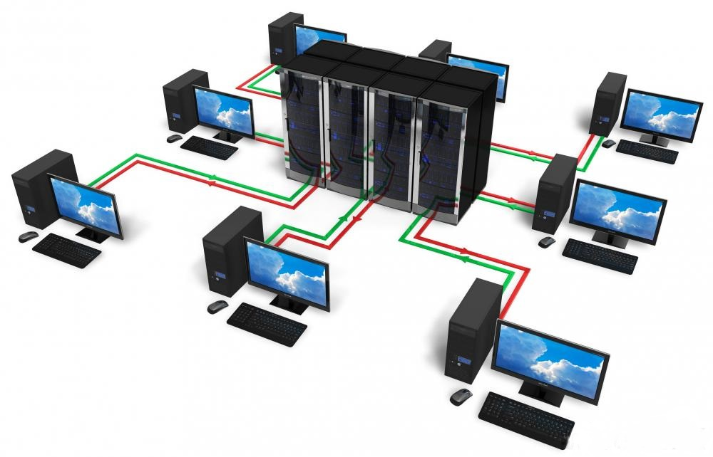
Web Servers
Apache, IIS, nginx, lighttpd

Slide 21
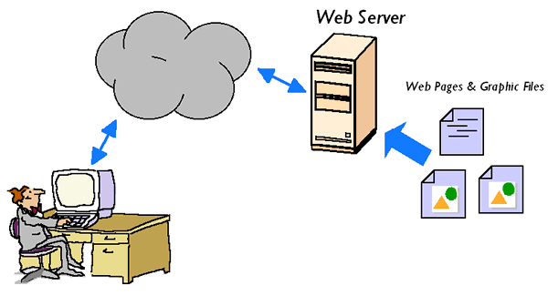
Web Server
The primary function of a web server is to store, process and deliver web pages to clients
Handle web requests
Serve web content
The communication between client and server takes place using the HTTP
These requests are redirected to other software products (ASP.NET, PHP, etc.), depending on the web server settings

Slide 22
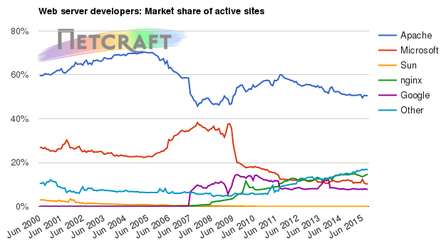
Web Servers Market Share – June 2015
Apache
~ 50.00 %
IIS (by Microsoft)
~ 10.00%
nginx (by Igor Sysoev)
~ 17.00%
Others
~ 19.00%

Slide 23
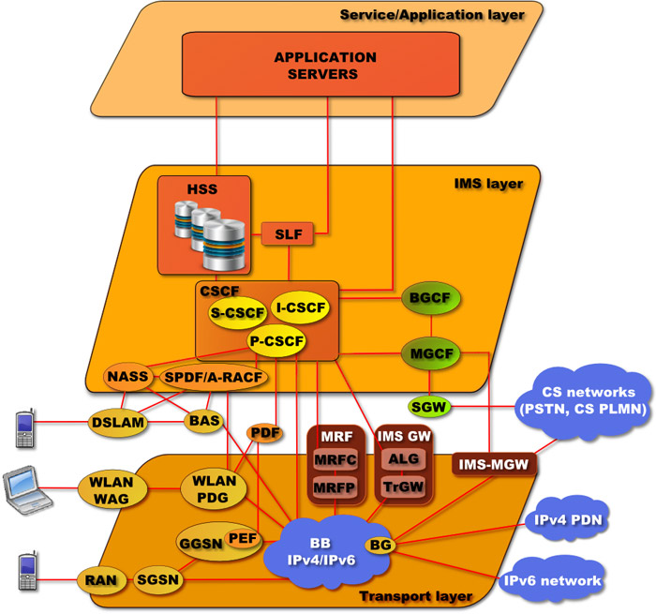
Software Architectures
Client-Server, Multi-Tier, SOA

Slide 24
Client-Server Architecture
Networks in which certain computers have special dedicated tasks. The client-server model consists of:
Server – a single machine or cluster of machines that provides web applications (or services) to multiple clients
Examples: IIS web server, WCF based service, cloud services
Client – software applications that provide UI (front-end) to access the services at the server
Examples: Web browser, WPF application, HTML5 application, Mobile application, Silverlight application…

Slide 25
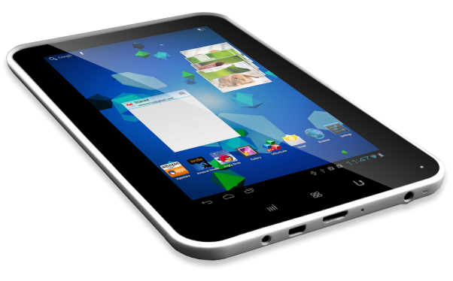
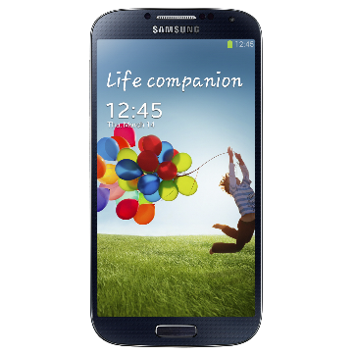
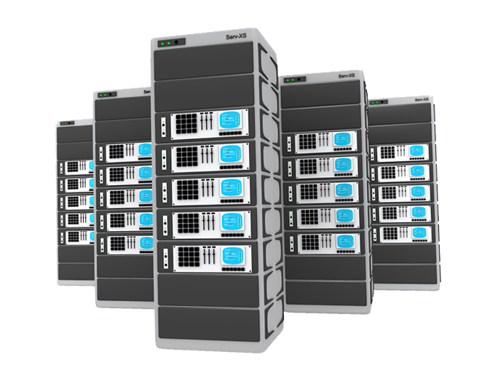
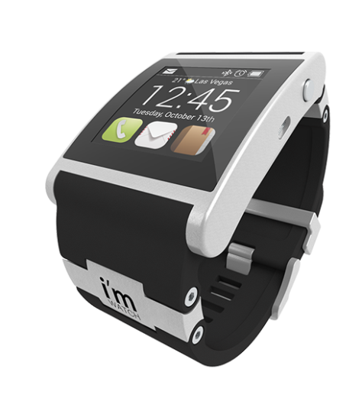

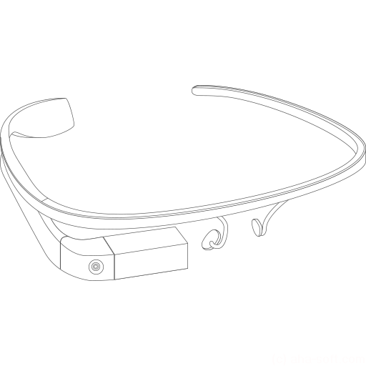
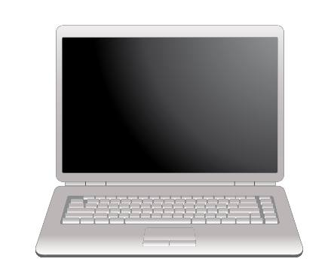
Client-Server Architecture
Client
Client
Server
Client
Client
network connection
network connection
network connection
Client
Client

Slide 26
Client-Server Model – Examples
Web server (Apache, IIS) – Web browser
FTP server (ftpd) – FTP client (FileZilla)
Email server (qmail) – email client (Outlook)
SQL Server – SQL Server Management Studio
BitTorrent Tracker – Torrent client (μTorrent)
DNS server (bind) – DNS client (resolver)
DHCP server (wireless router firmware) – DHCP client (mobile phone /Android DHCP client/)
SMB server (Windows) – SMB client (Windows)

Slide 27
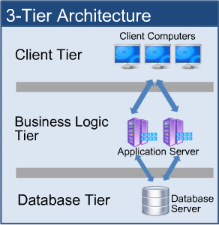
3-Tier / Multi-Tier Architectures
Three-tier architecture consists of the following layers:
Presentation layer (front-end)
Responsible for visualizing information
Provides the UI of the application
Application layer (business tier)
Responsible for application functionality
Provides the system logic
Data layer (back end)
Manages the data of the system

Slide 28





What is "Cloud"?

Slide 29
What is Cloud?
Cloud ≈ multiple hardware machines combine their computing power and resources
Share them between multiple applications
To save costs and use resources more efficiently
Public clouds
Provide computing resources on demand
Publicly in Internet
Paid or free of charge (to some limit)
Amazon AWS, Google App Engine, Microsoft Azure, Rackspace, AppFog, Heroku, AppHarbor, …

Slide 30
Cloud Computing Models
Infrastructure as a Service (IaaS)
Virtual machines in the cloud on demand
Users install the OS and software they need
Platform as a Service (PaaS)
Platform, services and APIs for developers
E.g. Java + JBoss + JSF + JPA + MongoDB or JavaScript + Node.js + MongoDB + RabbitMQ
Software as a Service (SaaS)
Hosted application on demand (e.g. WordPress)

Slide 31



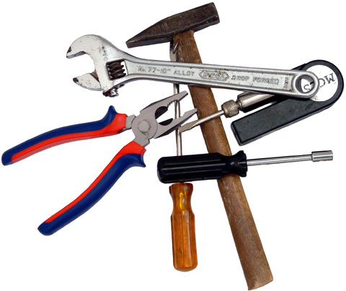
Web Development Tools

Slide 32


Text Editors with HTML & CSS Support
Notepad++ (Windows)
GEdit (Linux)

Slide 33





IDEs for HTML, CSS and JS
Visual Studio / Visual Web Developer
Microsoft Web Matrix
Eclipse
Sublime Text / Atom
Brackets
Aptana Studio
WebStorm
Adobe Edge
Adobe Dreamweawer

Slide 34
Zen Coding / Emmet
Emmet (formerly Zen Coding) is a shortcut syntax for speed-writing HTML and CSS, e.g.
Learn more at http://emmet.io
Download plugin for your IDE
<div>
<dl>
<dt></dt>
<dd></dd>
<dt></dt>
<dd></dd>
<dt></dt>
<dd></dd>
</dl>
</div>
<footer>
<p></p>
</footer>
(div>dl>(dt+dd)*3)+footer>p

Slide 35





Browsers and Browser Tools
Google Chrome
Web Developer Toolbar
Mozilla Firefox / Dev Edition
Firebug
Web inspector
Internet Explorer
F12
Opera
Inspect Element
Safari

Slide 36



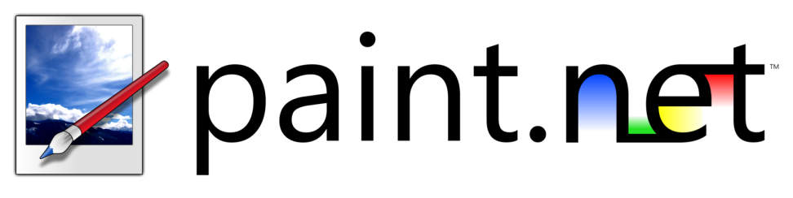
Drawing and Slicing Tools
Adobe Photoshop
Adobe Fireworks
Paint.NET
GIMP

Slide 37
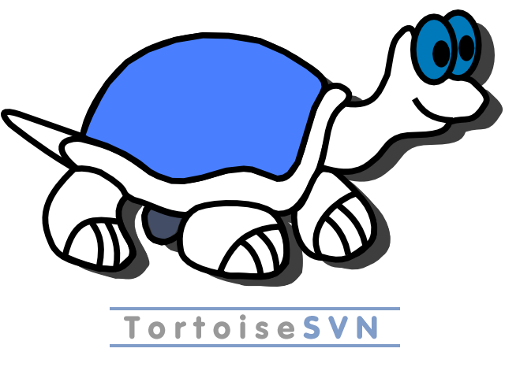


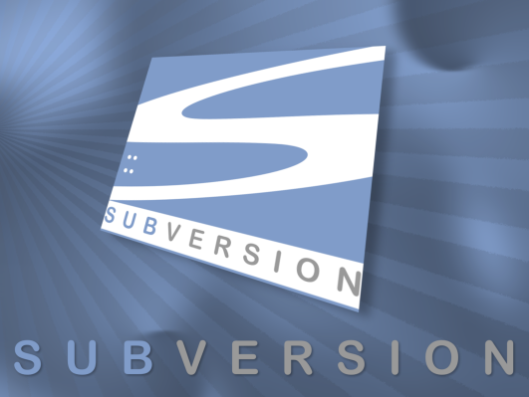

Source Control Systems
Git
SVN

Slide 38

Summary
Web pages == formatted text with images and hyperlinks
Web browser == visualizer for Web pages
Web site == a set of Web pages, styles and resources
Hardware Servers are machines that run the IT infrastructure
Cloud == computing resources in a data center
Web Servers == software serving Web content
Client-server architecture == device connects to a server
Tools – IDEs, Text editors, Browsers and tools
Source Control Systems

Slide 39








Web Technologies – Basic Concepts
https://softuni.bg/courses/web-fundamentals

Slide 40
License
This course (slides, examples, demos, videos, homework, etc.) is licensed under the "Creative Commons Attribution-NonCommercial-ShareAlike 4.0 International" license
Attribution: this work may contain portions from
"HTML Basics" course by Telerik Academy under CC-BY-NC-SA license
"CSS Styling" course by Telerik Academy under CC-BY-NC-SA license

Slide 41






Free Trainings @ Software University
Software University Foundation – softuni.org
Software University – High-Quality Education, Profession and Job for Software Developers
softuni.bg
Software University @ Facebook
facebook.com/SoftwareUniversity
Software University @ YouTube
youtube.com/SoftwareUniversity
Software University Forums – forum.softuni.bg

